Slide 1
Azure Databrics

Slide 2
Agenda
What is Azure Databrics?
Create Workspace and Cluster
Working with Notebooks and Jobs
Libraries Overview
Administration, Manage Users & Groups

Slide 3
What is Azure Databricks?
Apache Spark-based
Analytics platform
Provides
One-click setup
Streamlined workflows and
An interactive workspace
Enables collaboration between data scientists, data engineers, and business analysts.

Slide 4
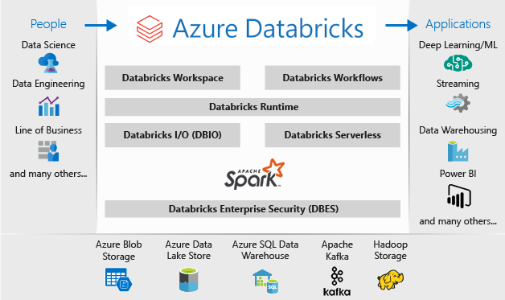
Azure Databricks

Slide 5
Azure Databricks
For a big data pipeline, the data is ingested into Azure
This data lands in
Azure Blob Storage or
Azure Data Lake Storage
Use Azure Databricks to read data from multiple data sources
Azure Blob Storage
Azure Data Lake Storage
Azure Cosmos DB, or
Azure SQL Data Warehouse
Using Databricks, turn it into breakthrough insights

Slide 6
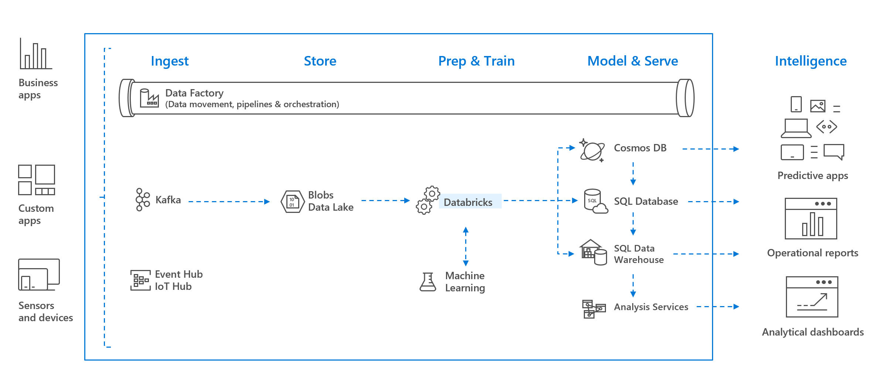
Azure Databricks

Slide 7
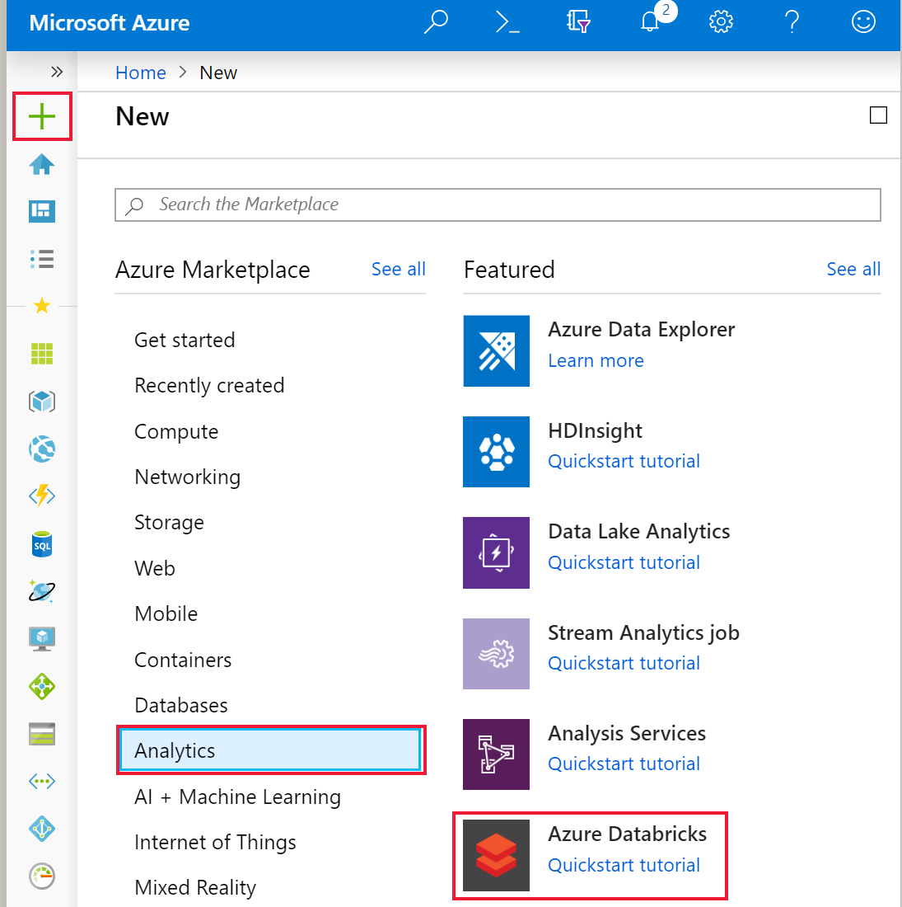
Hands-On: Create Databricks Workspace

Slide 8
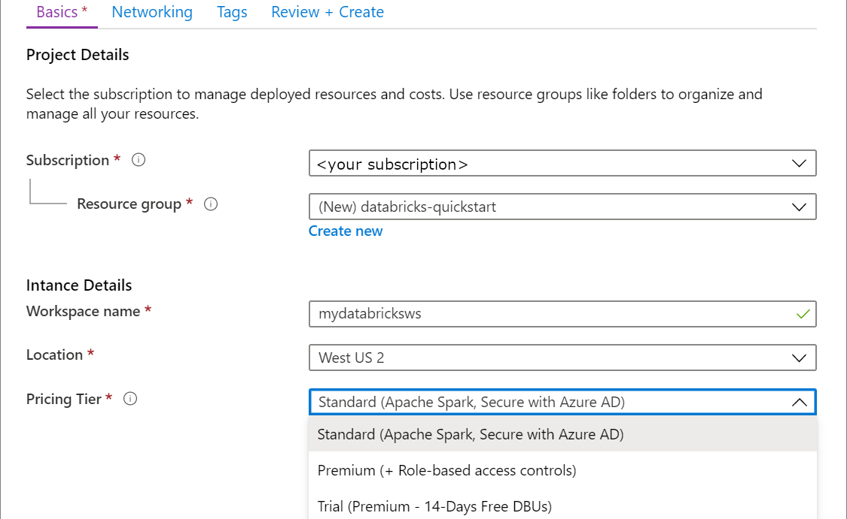
Hands-On: Create Databricks Workspace

Slide 9
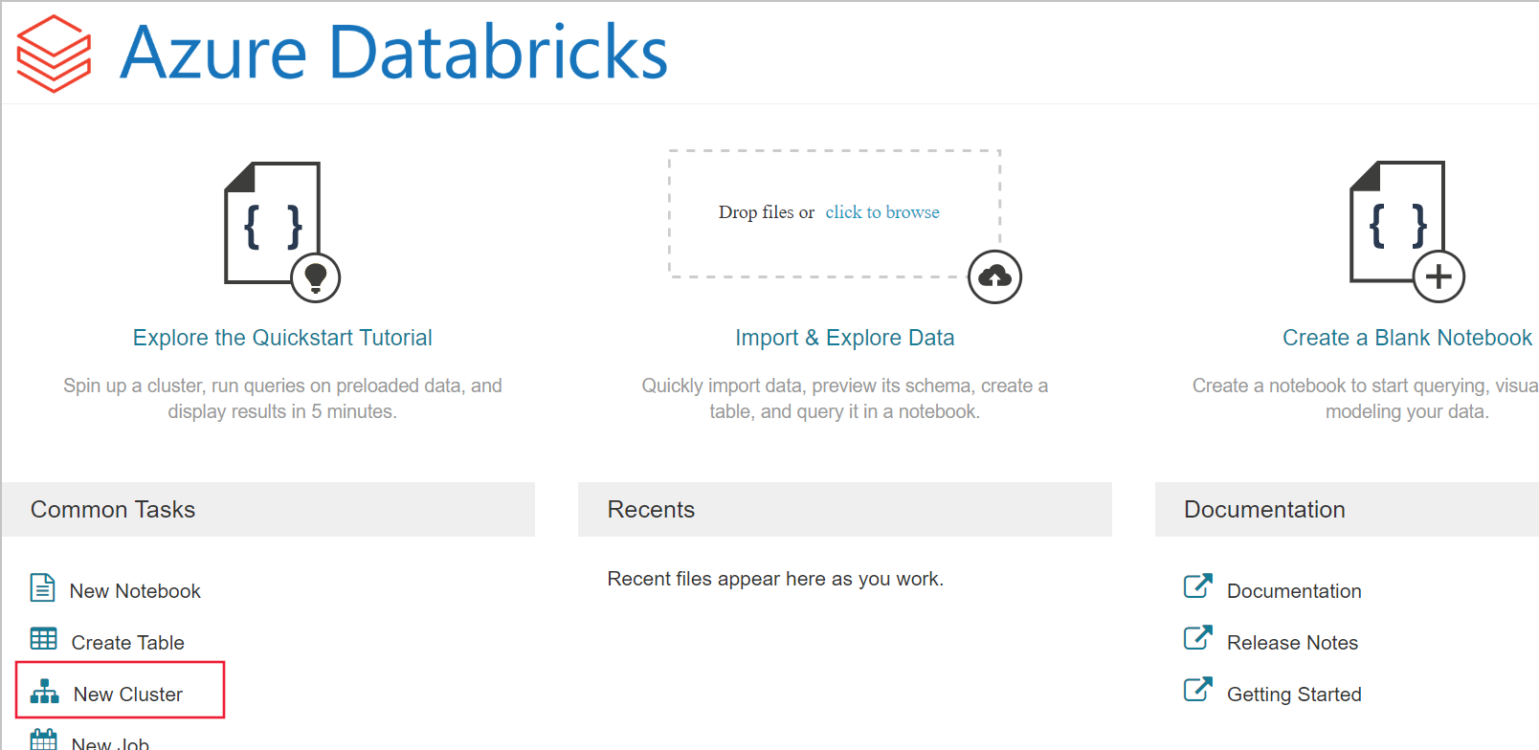
Hands-On: Create a Spark cluster in Databricks
Go to the Databricks workspace that you created, and then click Launch Workspace.
You are redirected to the Azure Databricks portal.
Click New Cluster

Slide 10
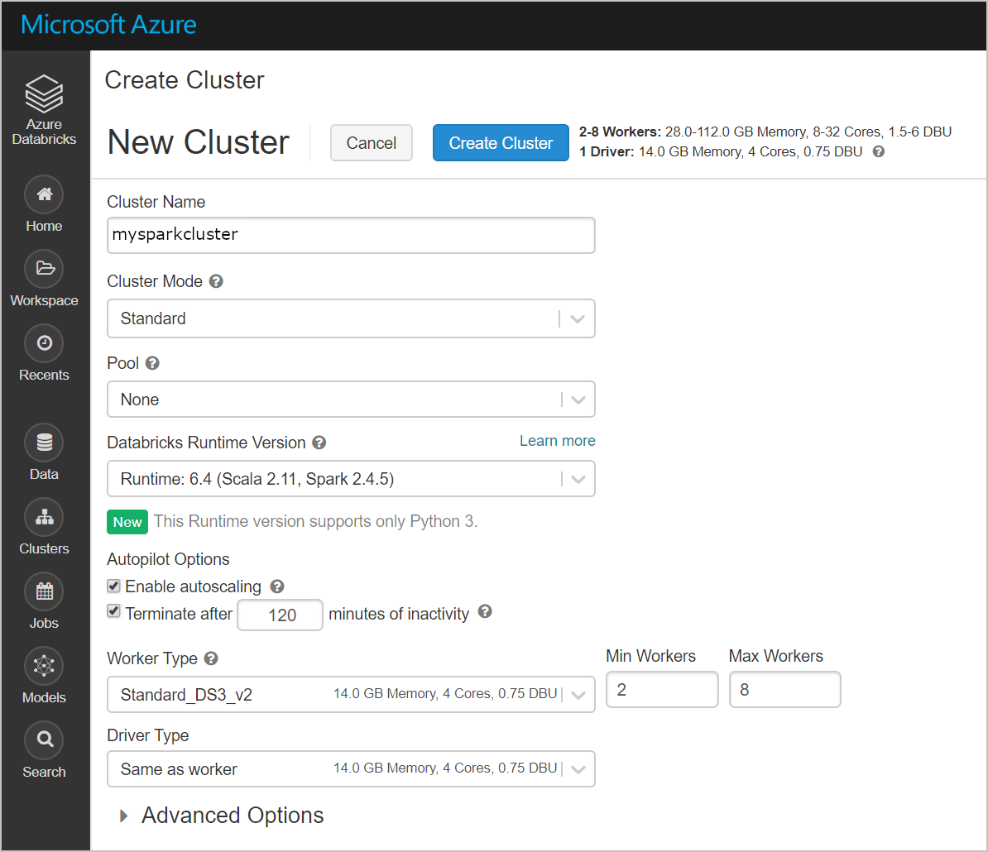
Hands-On: Create a Spark cluster in Databricks
Make sure you select the Terminate after __ minutes of inactivity checkbox
Provide a duration (in minutes) to terminate the cluster, if the cluster is not being used.

Slide 11
Run a Spark SQL job

Slide 12
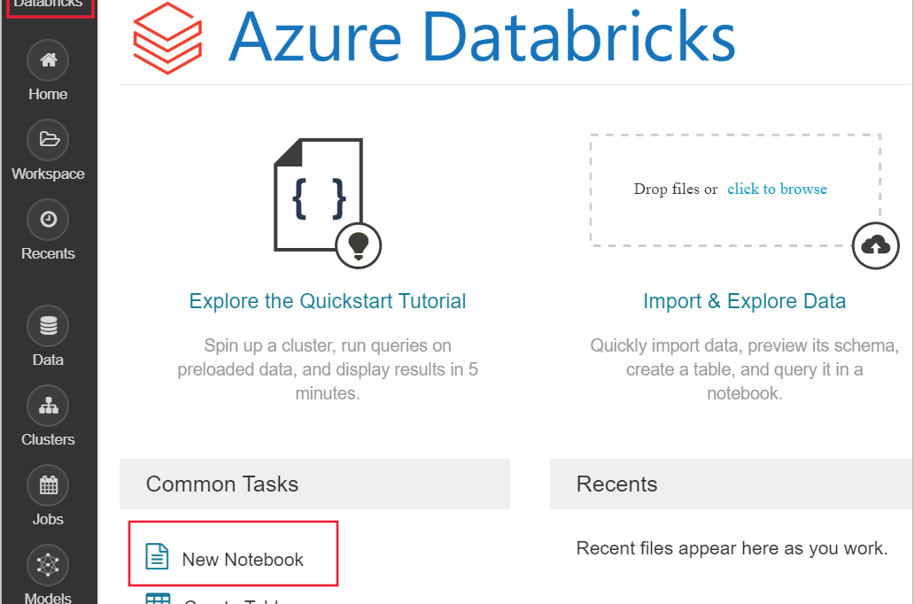
Hands-On: Run a Spark SQL job
Source Code: atinNotebook1.ipynb

Slide 13
Hands-On: Run a Spark SQL job
The following command sets the Azure storage access information.
blob_account_name = "azureopendatastorage"
blob_container_name = "citydatacontainer"
blob_relative_path = "Safety/Release/city=Boston"
blob_sas_token = r"?st=2019-02-26T02%3A34%3A32Z&se=2119-02-27T02%3A34%3A00Z&sp=rl&sv=2018-03-28&sr=c&sig=XlJVWA7fMXCSxCKqJm8psMOh0W4h7cSYO28coRqF2fs%3D"

Slide 14
Hands-On: Run a Spark SQL job
The following command allows Spark to read from Blob storage remotely
wasbs_path = 'wasbs://%s@%s.blob.core.windows.net/%s' % (blob_container_name, blob_account_name, blob_relative_path)
spark.conf.set('fs.azure.sas.%s.%s.blob.core.windows.net' % (blob_container_name, blob_account_name), blob_sas_token)
print('Remote blob path: ' + wasbs_path)

Slide 15
Hands-On: Run a Spark SQL job
The following command creates a DataFrame
df = spark.read.parquet(wasbs_path)
print('Register the DataFrame as a SQL temporary view: source')
df.createOrReplaceTempView('source')

Slide 16
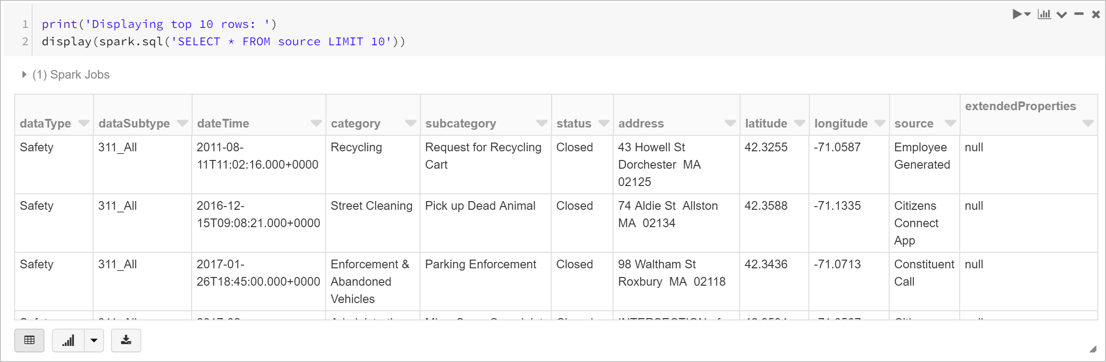
Hands-On: Run a Spark SQL job
Run a SQL statement return the top 10 rows of data
print('Displaying top 10 rows: ')
display(spark.sql('SELECT * FROM source LIMIT 10'))

Slide 17

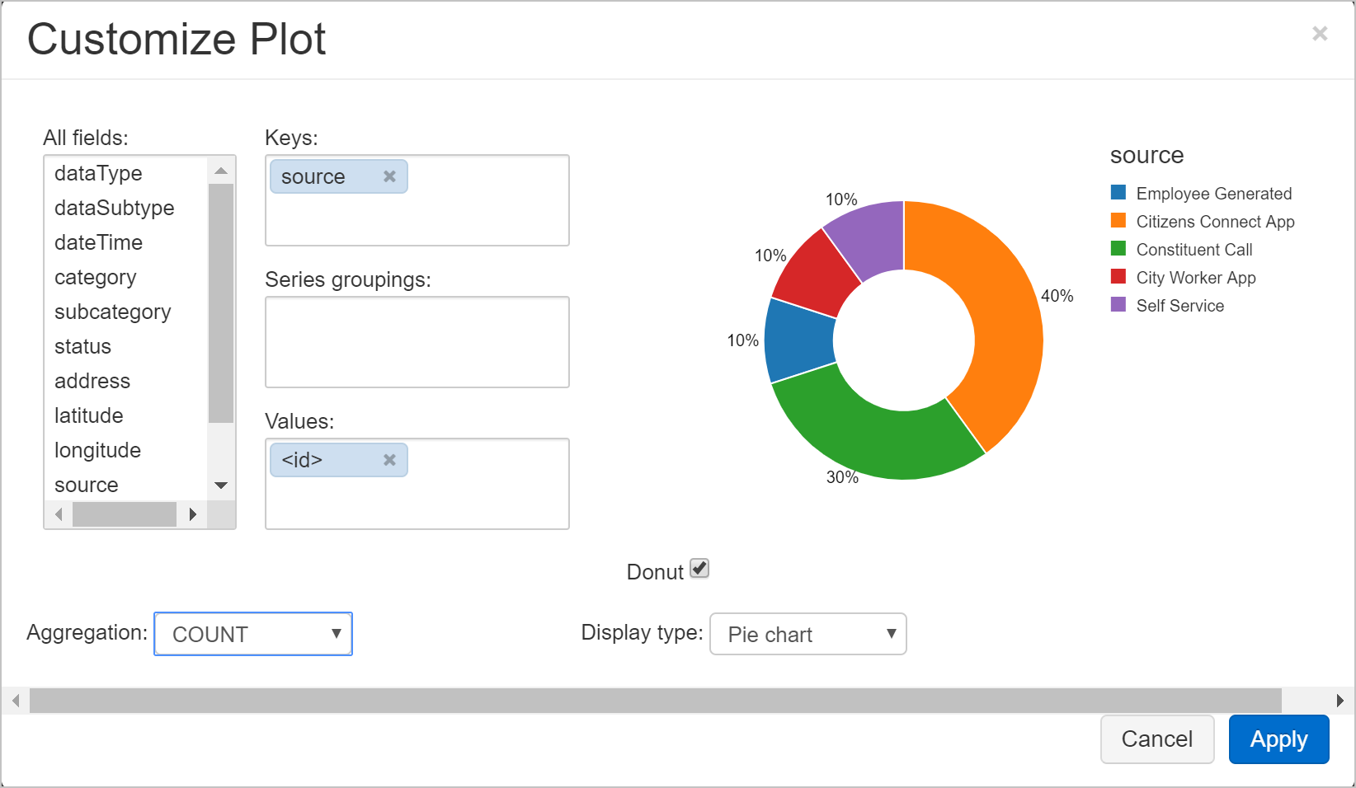
Hands-On: Run a Spark SQL job
You now create a visual representation of this data

Slide 18
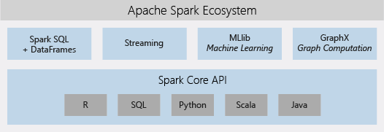
Apache Spark-based analytics platform

Slide 19
Azure Databricks concepts

Slide 20
Azure Databricks concepts
Workspace
Environment for accessing all of your Azure Databricks assets.
Organizes objects into folders

Slide 21
Objects
Notebooks
Libraries
Dashboards
Experiments

Slide 22
Notebook
A web-based interface for documents
Document contain
Runnable commands
Visualizations, and
Narrative text.

Slide 23
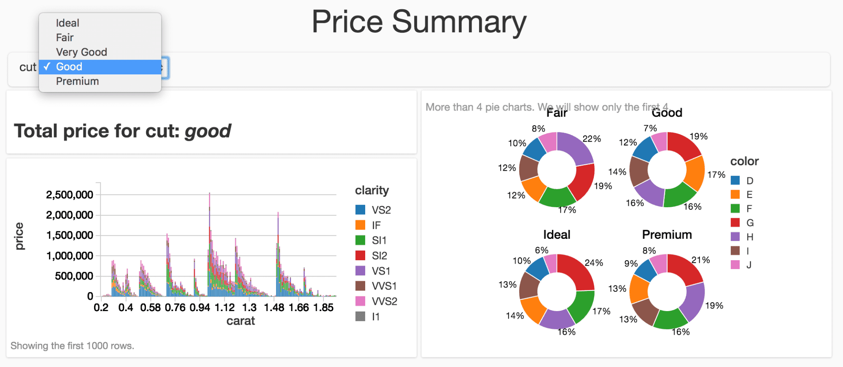
Dashboard
Provides access to visualizations

Slide 24
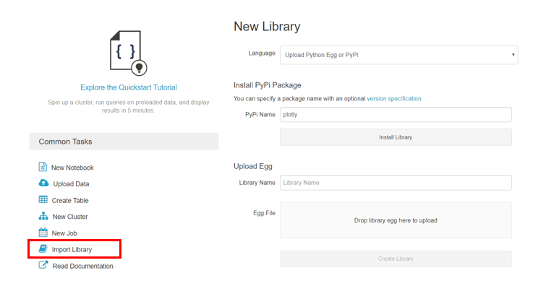
Library
A package of code available to the notebook
Databricks runtimes include many libraries
You can add your own.

Slide 25
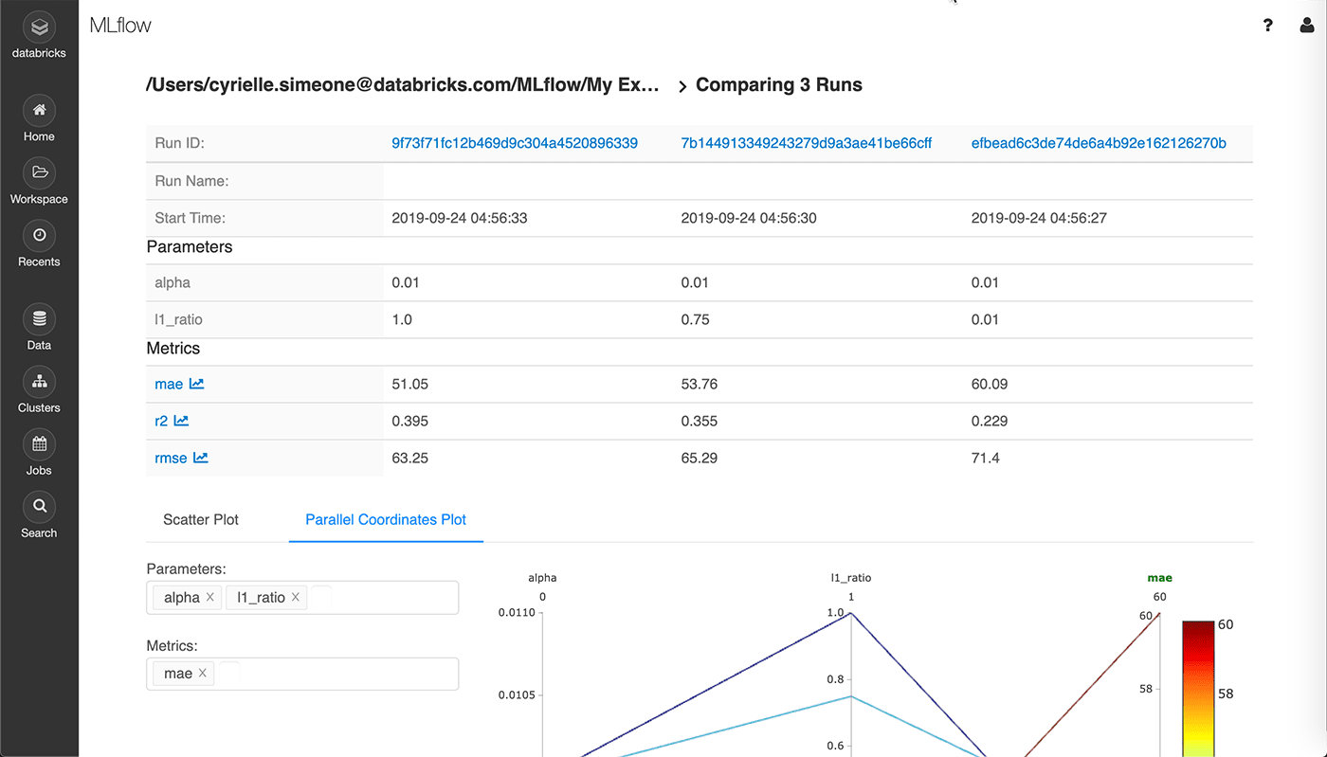
Experiment
A collection of MLflow runs for training a machine learning model.

Slide 26
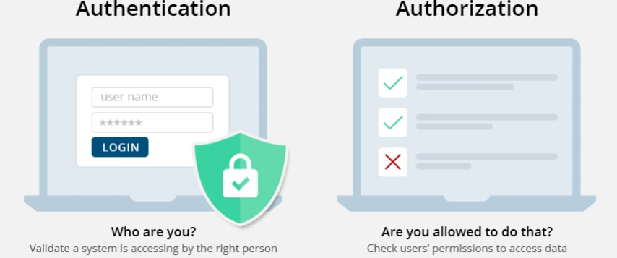
Authentication and authorization
User
A unique individual who has access to the system.
Group
A collection of users.
Access control list (ACL)
A list of permissions attached to the objects.
Specifies which users or system processes are granted access to the objects

Slide 27
Work with Notebooks

Slide 28
What is Notebook?
A web-based interface to a document that contains
Runnable code
Visualizations, and
Narrative text

Slide 29
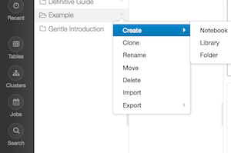
Hands-On: Create a notebook

Slide 30
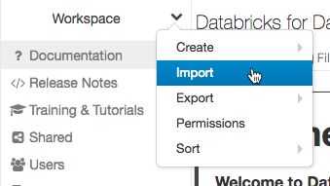
Hands-On
Open a Notebook
Delete a Notebook
Rename a notebook
Import a notebook
Export a notebook

Slide 31
Hands-On: Notebooks and clusters
Before you can do any work in a notebook, you must first attach the notebook to a cluster
Attach a notebook to a cluster
Detach a notebook from a cluster
View all notebooks attached to a cluster
Schedule a notebook

Slide 32
Work with Jobs

Slide 33
What is a Job?
A way of running a notebook on a scheduled basis
Can create and run jobs using the
UI
CLI
By invoking the Jobs API

Slide 34
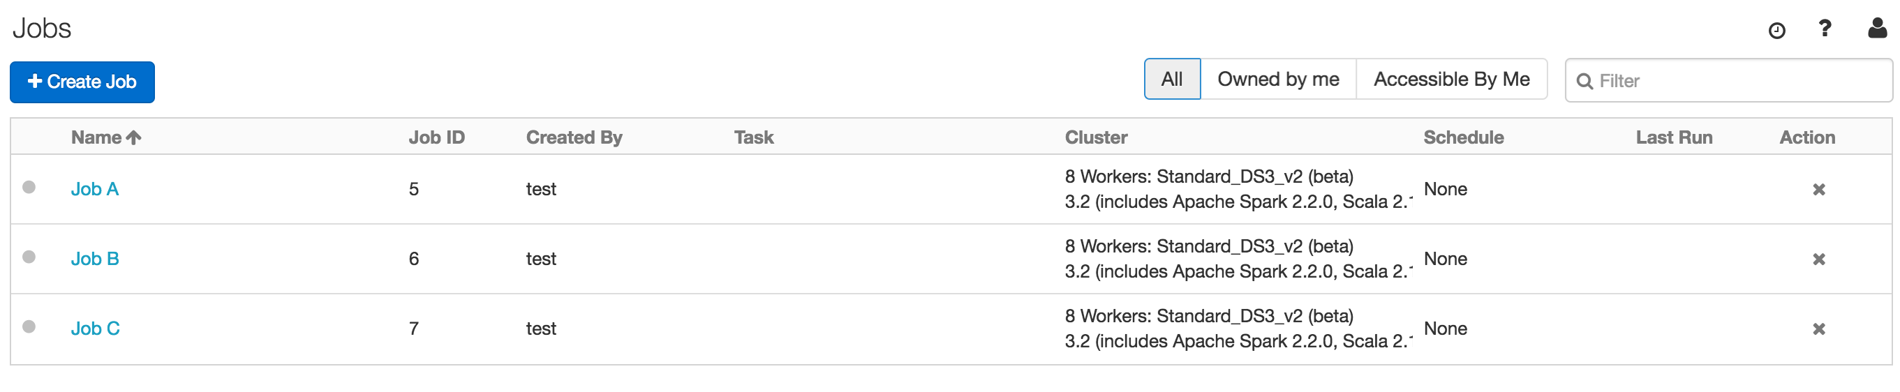
View jobs
Click the Jobs icon Jobs Menu Icon in the sidebar

Slide 35
Hands-On: Create a job

Slide 36
Hands-On: Run a job
Schedule a job
Pause and resume a job schedule
Run a job immediately

Slide 37
Hands-On: View job run details

Slide 38
Library dependencies
To get the full list of the driver library dependencies, run the following command inside a notebook
%sh
ls /databricks/jars

Slide 39
Libraries Overview

Slide 40
Libraries Overview
To make third-party or custom code available to notebooks and jobs running on your clusters, you can install a library.
Libraries can be installed using:
Workspace libraries
Serve as a local repository from which you create cluster-installed libraries
Cluster libraries
Can be used by all notebooks running on a cluster
Can install a cluster library directly from a public repository such as PyPI
Notebook-scoped Python libraries
Allow to install Python libraries and create an environment scoped to a notebook session
These libraries do not persist and must be re-installed for each session.

Slide 41
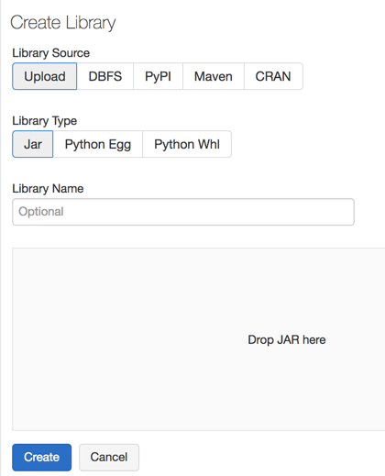
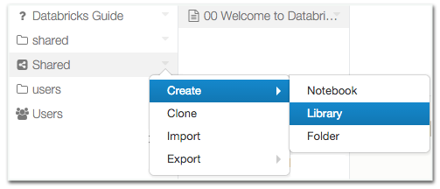
Hands-On: Create a workspace library
Right-click the workspace folder where you want to store the library.
Select Create > Library.

Slide 42
Hands-On: Install a library on a cluster
Two ways to install a library on a cluster:
Install a workspace library that has been already been uploaded to the workspace.
Install a library for use with a specific cluster only

Slide 43
Manage Users & Groups

Slide 44
HDInsight vs Databricks

Slide 45
HDInsight is full fledged Hadoop with a decoupled storage and compute.
Databricks is managed spark.
Databricks is focused on collaboration, streaming and batch with a notebook experience.
In Databricks, all your notebooks are available and ready for use
You don't need to think about anything else
HDInsight has Kafka, Storm and Hive that Databricks doesn’t have.
It is better for processing very large data sets in a “let it run” kind of way.
Databricks is a lot more user friendly and easier to manage
Azure HDInsight brings both Hadoop and Spark under the same umbrella

Slide 46
When to use HDInsight?
Very reliable when we know the workloads and the cluster sizes
Using Hive is a perk, as its being open source and very similar to SQL
By using Hive, we take full advantage of MapReduce power
Which shines in situations where there are huge amounts of data.

Slide 47
When to use Databricks?
Databricks is an ideal choice when
The notebook interactive experience is a must
When data engineers and data scientists must work together to get insights from data
Another perk of using Databricks is its speed, thanks to Spark

Slide 48
Feature wise Comparison
 | HDInsight | Databricks
Engine | Apache Hive or Apache Spark | Apache Spark, optimized for Databricks
Default Environment | Ambari (HortonWorks), Zeppelin if using Spark | Databricks Notebooks, RStudio for Databricks
De Facto Language | HiveQL, open source | R, Python, Scala, Java, SQL
Scalability | Not scalable, requires cluster shutdown to resize | Easy to change machines and allows autoscaling
Setup and managing | Complex, we must decide cluster types and sizes | Easy, Databricks offers two main types of services and clusters can be modified with ease
References:
https://www.clearpeaks.com/cloud-analytics-on-azure-databricks-vs-hdinsight-vs-data-lake-analytics/

Slide 49


